Slide 1
A Data science Project on
micro credit defaulter project
Submitted by: Santosh Arvind Dharam

Slide 2
Problem Statement
In order to improve the selection of customers for the credit, the client wants some predictions that could help them in further investment and improvement in selection of customers.
Build a model which can be used to predict in terms of a probability for each loan transaction, whether the customer will be paying back the loaned amount within 5 days of insurance of loan. In this case, Label ‘1’ indicates that the loan has been payed i.e. Non- defaulter, while, Label ‘0’ indicates that the loan has not been payed i.e. defaulter.

Slide 3
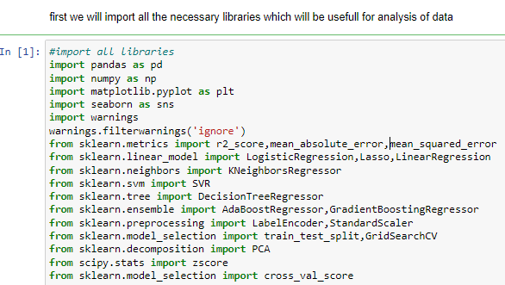
EDA steps step-1(import necessary libraries)

Slide 4
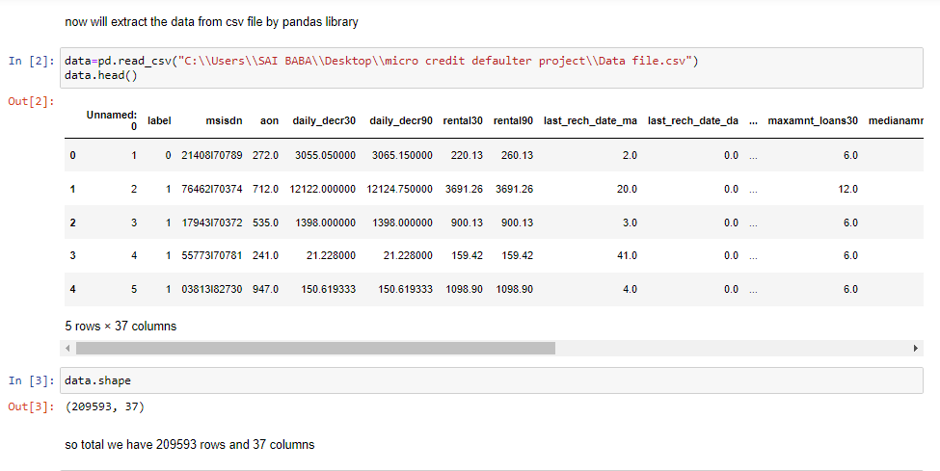
Step-2(extract the dataset in jupyter notebook)

Slide 5
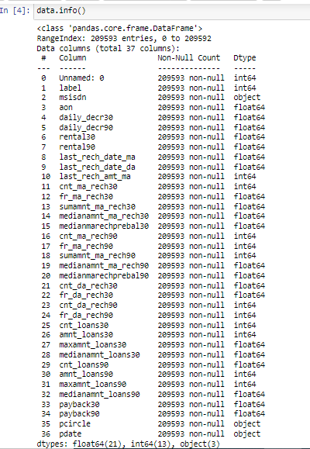
Basic information about data it gives the information about the column data type with no null values in it ,with Range Index: 209593 and total no of column are 37

Slide 6
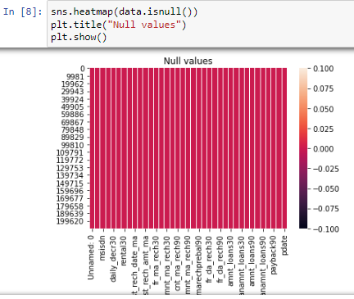
Heatmap for null values it represent there is no null values in dataset

Slide 7
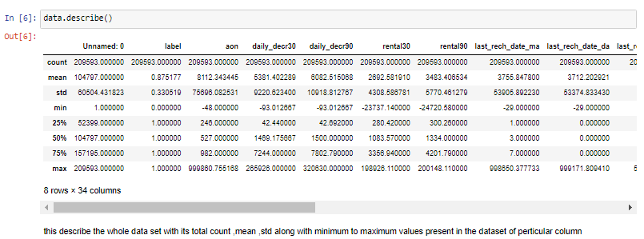
Description of Data it gives the detail description of data with its mean,std,mini to max values present in the data column

Slide 8
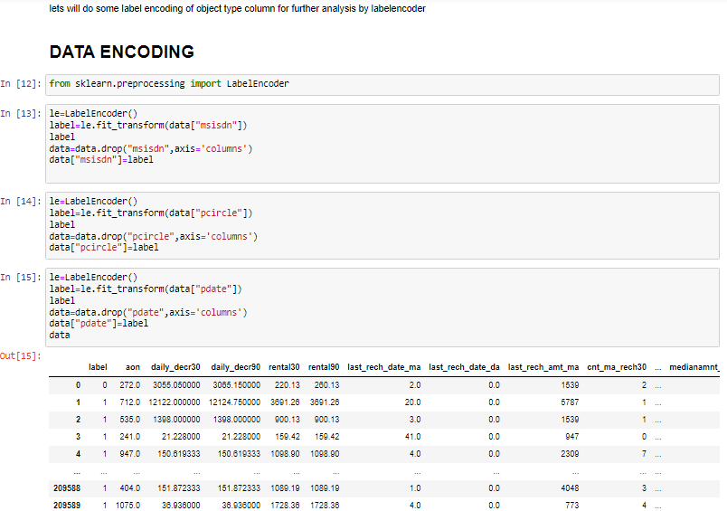
Step-3(Encoding the dataset) now all the columns are converted into float or integer type so we can do the further analysis

Slide 9
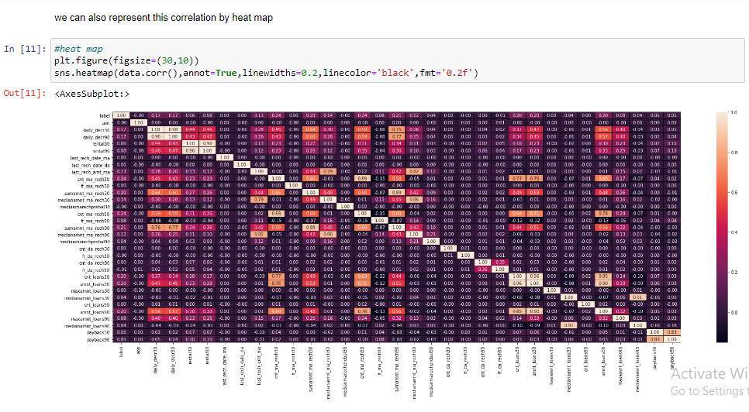
Data correlation it represent the correlation between different column with the target column some column shows zero correlation with the target variable so lets drop this column in successive steps

Slide 10
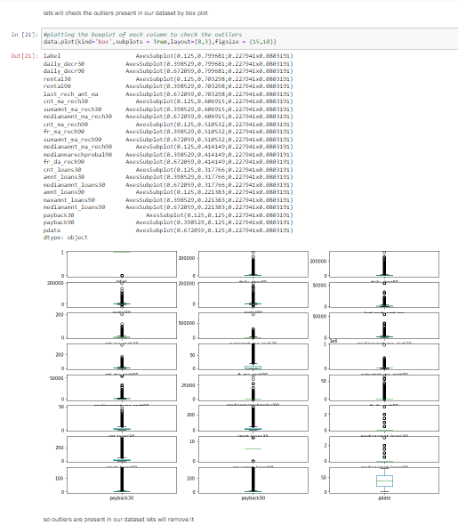
Step-5(visualization) so data contains outliers present in it let will remove it in further steps

Slide 11
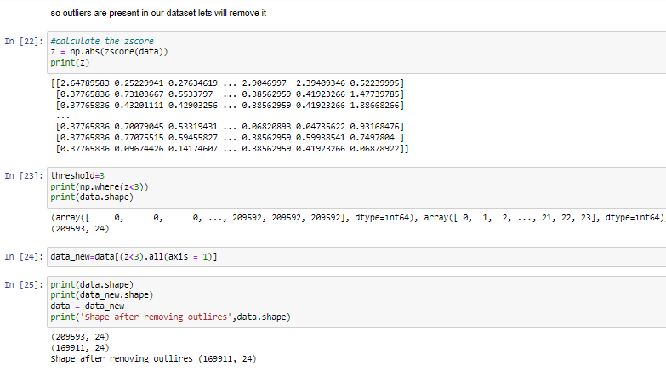
Outlier removal so we have removed outliers present in the dataset

Slide 12
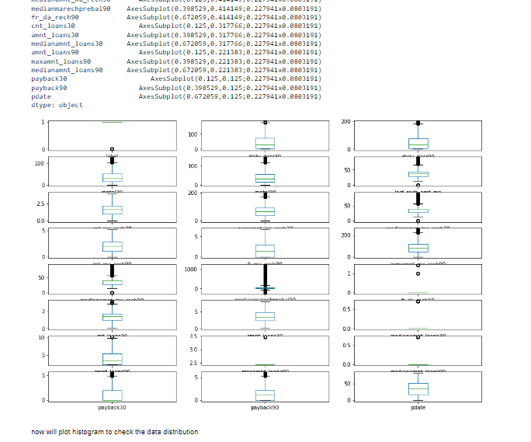
data representation After removing outliers

Slide 13
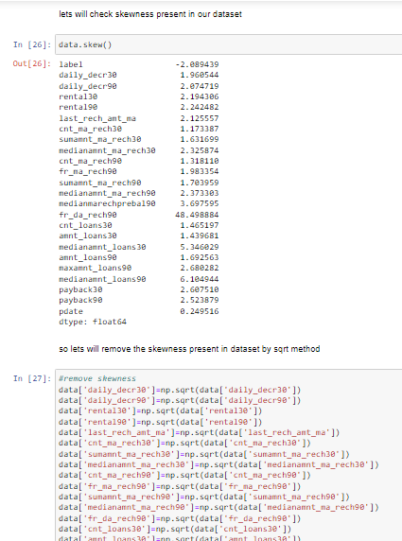
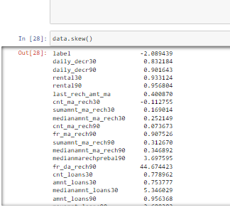
Skewness detection & removal

Slide 14
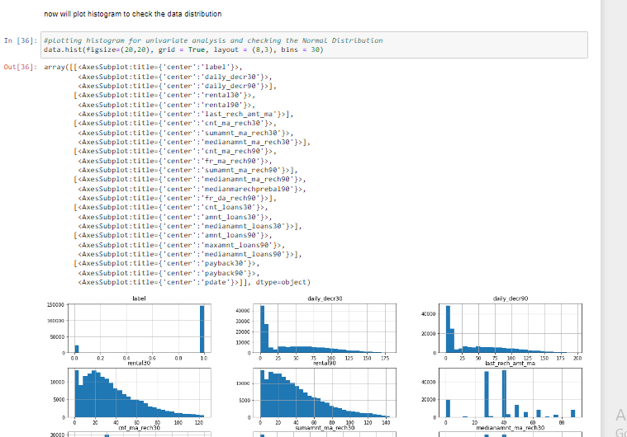
Data distribution by histogram

Slide 15
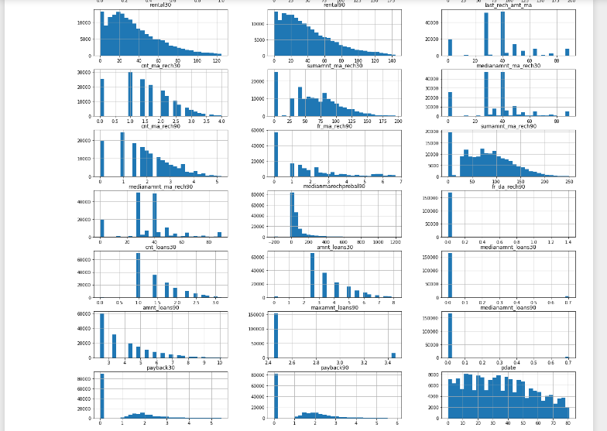

Slide 16
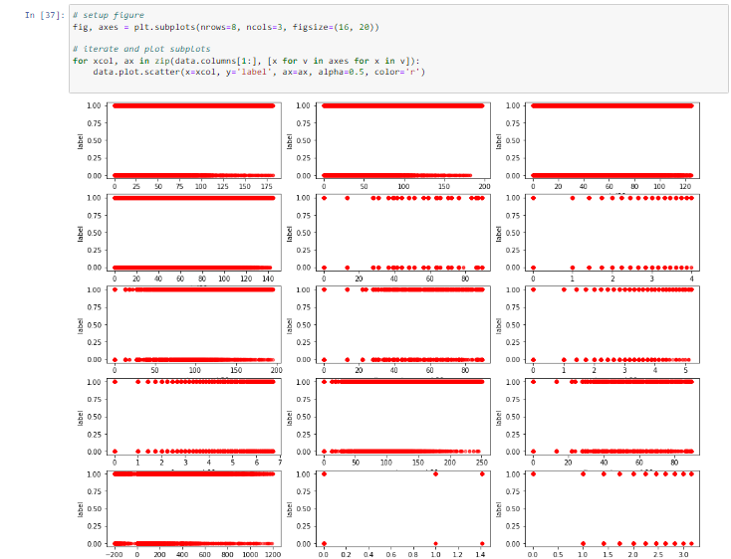
Scatter plot

Slide 17
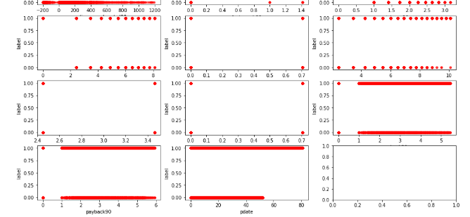

Slide 18
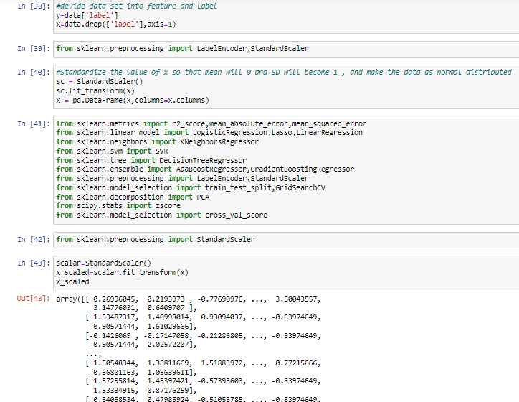
Model Building

Slide 19
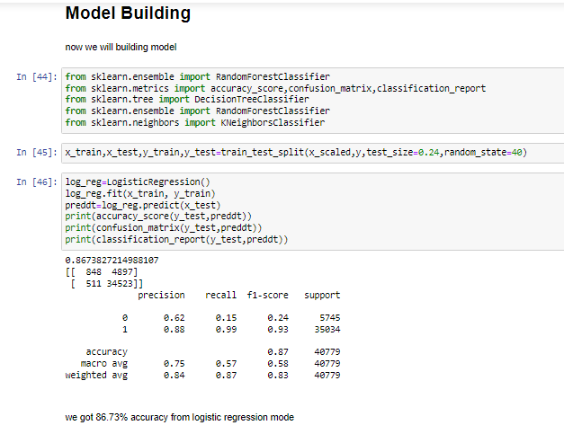
Model Building

Slide 20
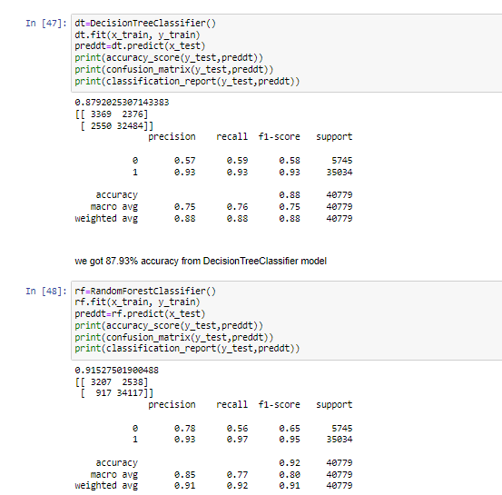

Slide 21
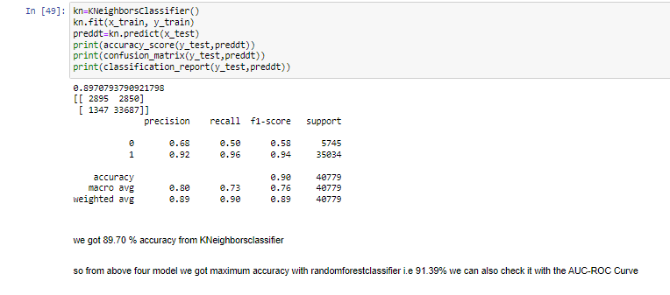

Slide 22
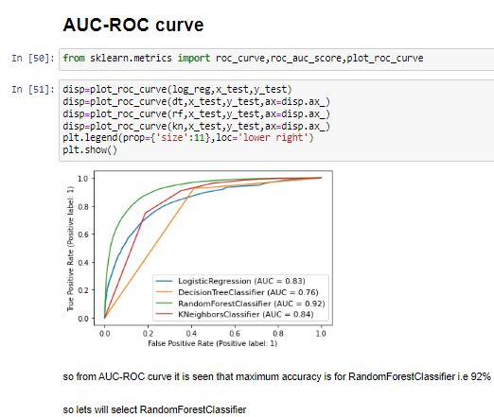
AUC-ROC Curve

Slide 23
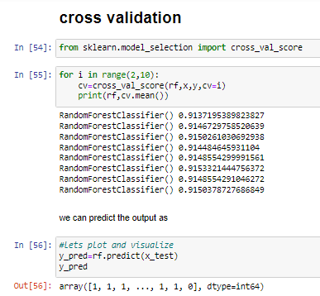
Cross-Validation

Slide 24
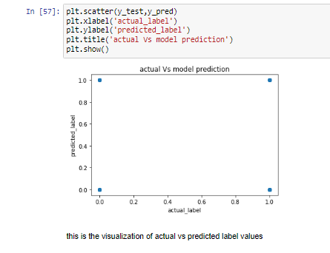
Actual vs predicted output

Slide 25
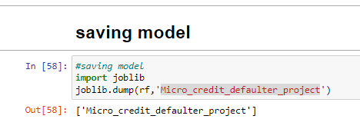
Saving Model So we have selected RandomForestClassifier() model ,so will save it for future data prediction

Slide 26
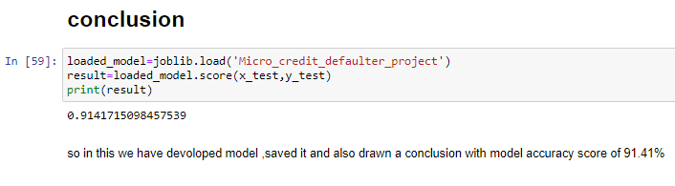
Conclusion So in this way we have developed model by checking its accuracy through various stages also we have saved the model ,accuracy from saved model is drawn 91.41%.so now we can use this saved model for the future data prediction

